Slide 1
pandas Merge, Join, Concat, Append
Comprehensive Pandas Tutorial

Slide 2


pd.merge( )
Suppose, we have
dataframe A and dataframe B
Comprehensive Pandas Tutorial

Slide 3
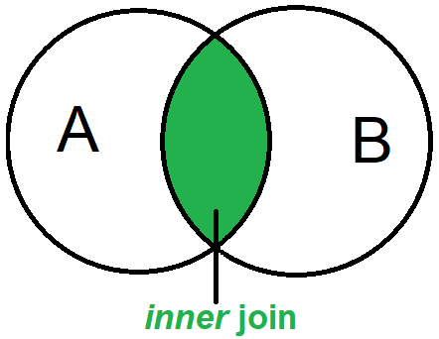
Inner Join
+
Comprehensive Pandas Tutorial

Slide 4
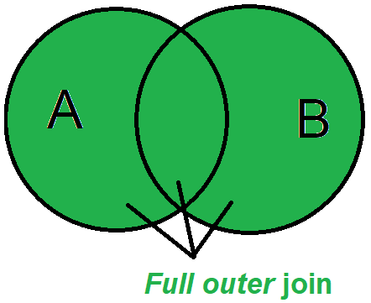
Outer Join
+
Comprehensive Pandas Tutorial

Slide 5
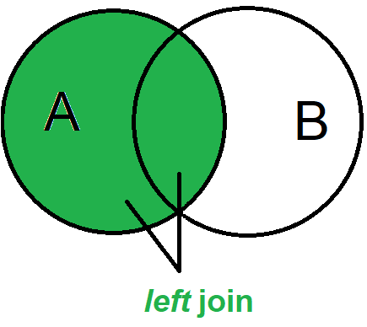
Left Join
+
Comprehensive Pandas Tutorial

Slide 6
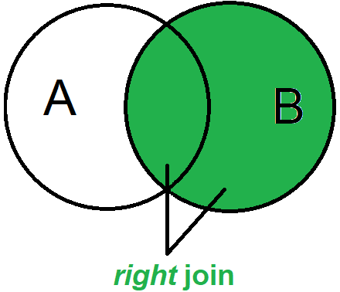
Right Join
+
Comprehensive Pandas Tutorial

Slide 7
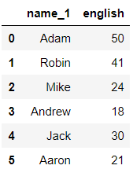
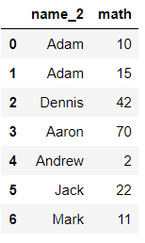
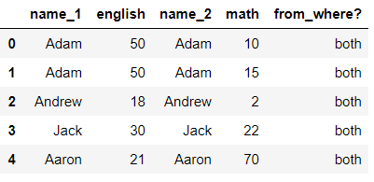
how=‘inner’
eng df
math df
inner merged df
First element in the ‘key’ column of left df is Adam.
Now, do you see Adam in right df? Yes at index 0. Add that row from both dfs in the result df.
Now is there any other Adam in the right df? Yes at index 1. Hence now add this row as well along with Adam 50 from ‘eng df’. Now we’ve run out of Adam’s.
Next element in left df is Robin. Do you see any Robin in right df? No, hence discard this row.
Continue in the same vein.
Comprehensive Pandas Tutorial

Slide 8
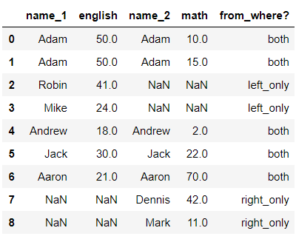
how=‘outer’
outer merged df
eng df
math df
First element in the ‘key’ column of left df is Adam.
Now, do you see Adam in right df? Yes at index 0. Add that row from both dfs in the result df.
Now is there any other Adam in the right df? Yes at index 1. Hence now add this row as well along with Adam 50 from ‘eng df’. Now we’ve run out of Adam’s.
Next element in left df is Robin. Do you see any Robin in right df? No, but since this is outer join, add this row regardless and include NaNs in name_2 & math cols of result df, because these two values don’t exist.
Continue in the same vein.
Comprehensive Pandas Tutorial

Slide 9
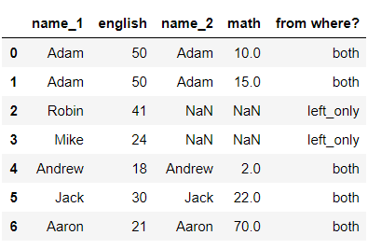
how=‘left’
eng df
math df
left merged df
First element in the ‘key’ column of left df is Adam.
Now, do you see Adam in right df? Yes at index 0. Add that row from both dfs in the result df.
Now is there any other Adam in the right df? Yes at index 1. Hence now add this row as well along with Adam 50 from ‘eng df’. Now we’ve run out of Adam’s.
Next element in left df is Robin. Do you see any Robin in right df? No, but since this is in left df, add this row regardless. Same with Mike row.
Continue in the same vein.
Comprehensive Pandas Tutorial

Slide 10
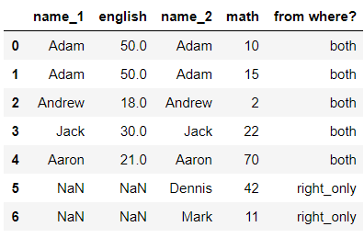
how=‘right’
eng df
math df
right merged df
First element in the ‘key’ column of left df is Adam.
Now, do you see Adam in right df? Yes at index 0. Add that row from both dfs in the result df.
Now is there any other Adam in the right df? Yes at index 1. Hence now add this row as well along with Adam 50 from ‘eng df’. Now we’ve run out of Adam’s.
Next element in left df is Robin. Do you see any Robin in right df? No, but because Robin is only in left df, discard this row. Same with Mike row.
Finally, after finishing with all ‘key’ elements in left df, we see Dennis and Mark untouched. But because this is only in the right df, add this row regardless.
Comprehensive Pandas Tutorial

Slide 11
left_df.join(right_df)
Join is built using pd.merge internally.
So you can totally NEVER learn pandas’ join and always rely on pandas’ merge for all your dataframe joining needs.
But it is never too bad to learn something which pandas’ developers thought might be useful for us in some scenarios. (and we can all safely assume they’re quite brainy people)
Join is useful when both left_df and right_df have the columns to be joined upon as their respective indexes.
This spares us the time to specify the ‘on’ column on which we have to join the dataframes. They’re automatically assumed by pandas to be joined on the indexes.
If not, then at least the right_df must have the column to joined upon as its index, and we can specify an argument of: on = ‘some_column‘ which is present in left_df.
The dataframes will be glued together using this ‘some_column‘ of the left_df and the index of the right_df.
By default, the ‘how’ parameter is set to ‘left’.

Slide 12
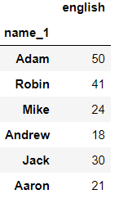
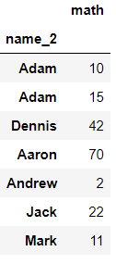
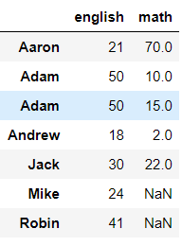
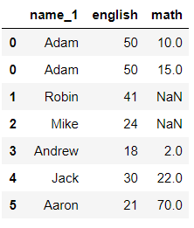
.join
NOTE: left join by default in both cases
In the case where only right df has keys as index, and left does not:
on = ‘name_1’
.join

Slide 13
pd.concat([df1, df2, …])
Can concatenate on either axes
Only has options for join=‘inner’ and ‘outer’
By default, it does an outer join so that there is no information loss on concatenation
If axis=0, i.e. if dataframes are placed one below the other, column names are matched. New columns are created for each uncommon column in either dataframe. (join=‘outer’)
If axis=1, i.e. if dataframes are placed besides one another, indexes are matched. New rows are created for each uncommon index in either dataframe. (join=‘outer’)

Slide 14
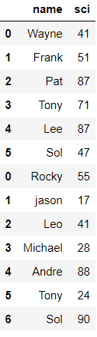
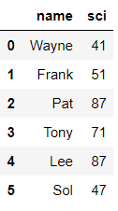
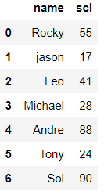
left_obj.append(right_obj)
The two objects can be any combination of dataframes and series.
Can only append two objects one below the other.
If similar columns, appends to the same column.

Slide 15
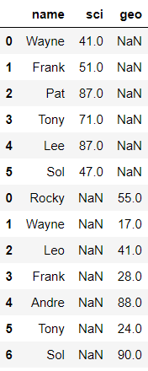
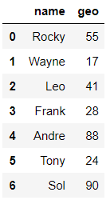
append
If dissimilar columns, then makes a different column for each dissimilar column

